Slide 1

Unearthing Earth's Riches: Minerals and Energy Resources
Minerals are naturally occurring, solid, inorganic substances with a definite chemical composition and internal atomic structure. They are fundamental building blocks of our planet, essential for industrial development and daily life.

Slide 2


The Study and Occurrence of Minerals
Geographers delve into the spatial distribution, economic significance, and environmental impact of mineral resources. They analyse how minerals influence land use patterns and regional development.
Geologists, conversely, focus on the formation, physical and chemical properties, and modes of occurrence of minerals within the Earth's crust. Their work helps in identifying potential mineral deposits.
Minerals occur in various forms: in igneous and metamorphic rocks (veins, lodes), sedimentary rocks (beds, layers), through decomposition of surface rocks, and as alluvial deposits in sands of valley floors.

Slide 3

Classification of Minerals and Manganese Production in India (2018-19)
Minerals are broadly classified into metallic (e.g., iron ore, bauxite) and non-metallic (e.g., limestone, mica) categories. Metallic minerals are further grouped as ferrous, non-ferrous, and precious metals.
Odisha
Madhya Pradesh
Maharashtra
Karnataka
Other States
Manganese is a vital ferrous metallic mineral primarily used in the manufacturing of steel. Odisha emerged as the leading producer in India, contributing over one-third of the total production in 2018-19.

Slide 4
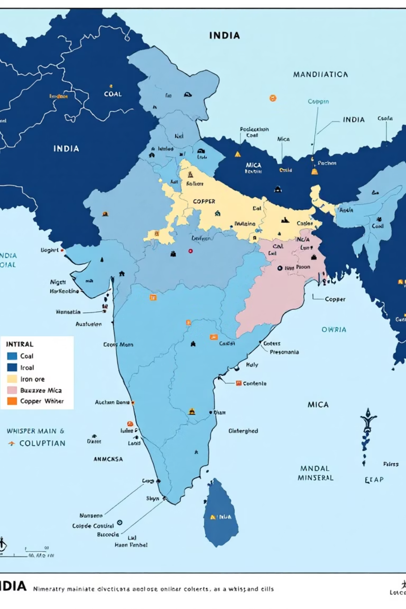
Important Mineral-Rich Regions of India
India is blessed with a diverse range of mineral resources. The peninsular plateau region holds significant reserves of coal, metallic minerals, mica, and other non-metallic minerals.
Key mineral belts include the Chota Nagpur Plateau, Karnataka plateau, and the Gujarat-Rajasthan belt, each contributing unique mineral wealth to the nation's economy.

Slide 5


Bauxite and Limestone Production in India (2018-19)
Bauxite Production
Limestone Production
Odisha
Gujarat
Jharkhand
Rajasthan
Madhya Pradesh
Andhra Pradesh
Maharashtra
Other States
Chhattisgarh
Other States
Bauxite, the primary ore for aluminium, is predominantly found in Odisha, which accounts for nearly half of India's production.
Limestone, a non-metallic mineral, is crucial for the cement industry. Rajasthan, Madhya Pradesh, and Andhra Pradesh are key producers.

Slide 6

Hazards Associated with Mining Activities
Environmental Degradation
Air and Water Pollution
Mining often leads to land degradation, deforestation, and soil erosion. Open-cast mining, in particular, scars landscapes and disrupts ecosystems.
Dust generated from mining operations causes severe air pollution. Water bodies are contaminated by acid mine drainage and discharge of toxic effluents.
Occupational Health Risks
Miners face significant health hazards, including respiratory diseases like silicosis and asbestosis, hearing loss, and injuries due to hazardous working conditions.
Sustainable mining practices and strict regulations are imperative to mitigate these adverse impacts and ensure the well-being of both the environment and the workforce.

Slide 7
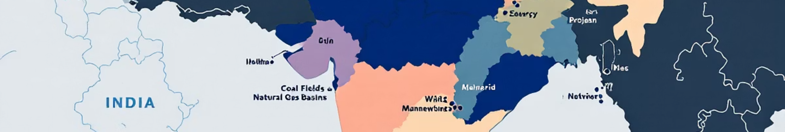
Energy Resources: The Lifeline of Development
Energy resources are indispensable for all forms of human activity, from powering industries to lighting homes. They are broadly categorised into conventional and non-conventional sources.
Conventional Sources
Non-Conventional Sources
These are traditional sources, exhaustible and widely used, primarily fossil fuels like coal, petroleum, and natural gas. Hydroelectricity also falls under this category.
These are renewable, sustainable, and eco-friendly sources like solar, wind, tidal, geothermal, and atomic energy, offering a cleaner alternative.
India's energy sector relies heavily on conventional sources, but there is a growing emphasis on transitioning to non-conventional alternatives for energy security and sustainability.

Slide 8
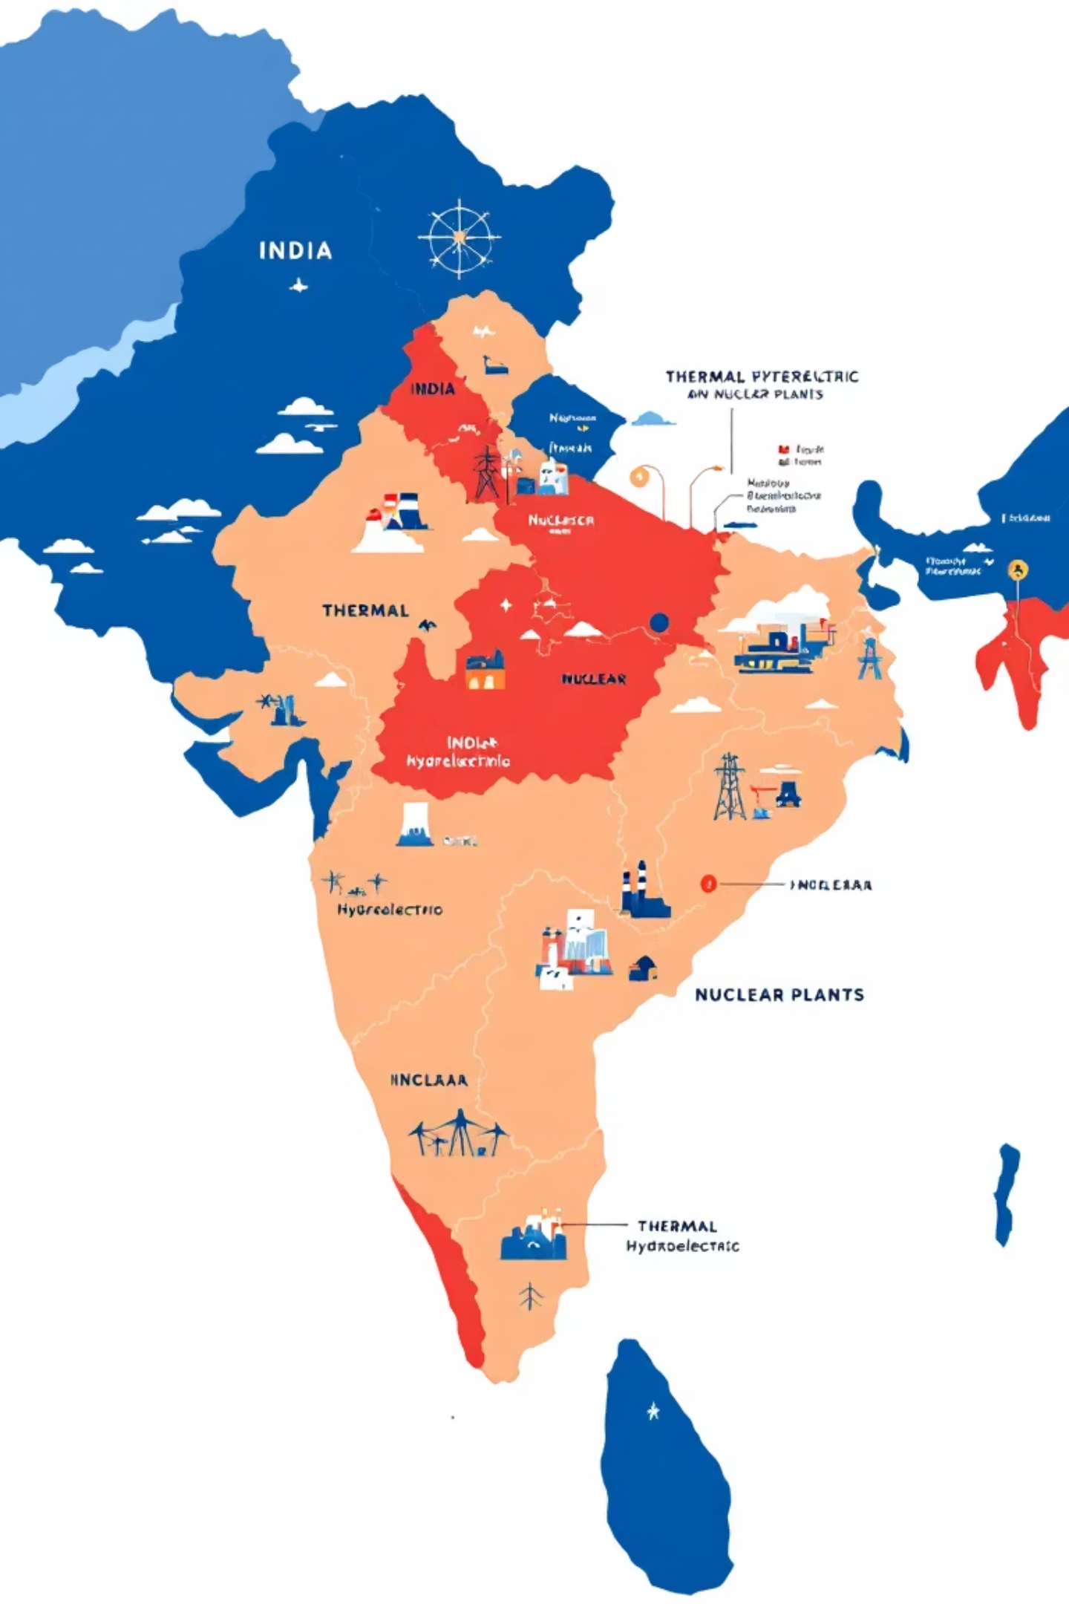

Key Conventional Energy Sources in India
Petroleum
Crude oil is refined into petrol, diesel, kerosene, and other products. Major basins are in Assam, Gujarat, Mumbai High, and the Krishna-Godavari delta.
Natural Gas
An eco-friendlier fossil fuel, used as industrial fuel, for power generation, and as Compressed Natural Gas (CNG) for vehicles. Reserves are found in similar regions as petroleum.
Electricity
Generated from thermal (coal-based), hydro (water-based), and nuclear power plants. It powers industries, agriculture, and urban-rural households.
The development of a robust energy infrastructure, encompassing generation, transmission, and distribution, is crucial for India's economic growth and social progress.

Slide 9
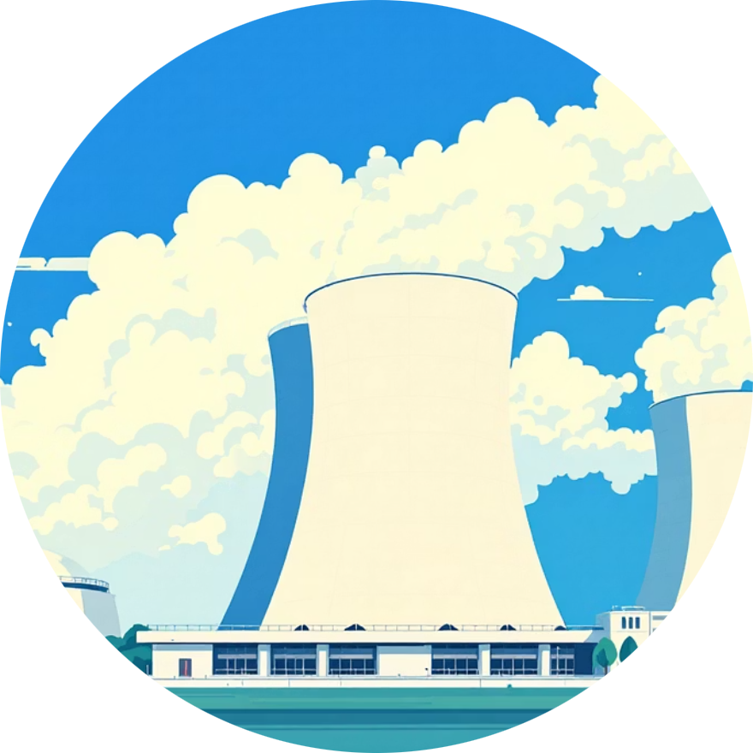


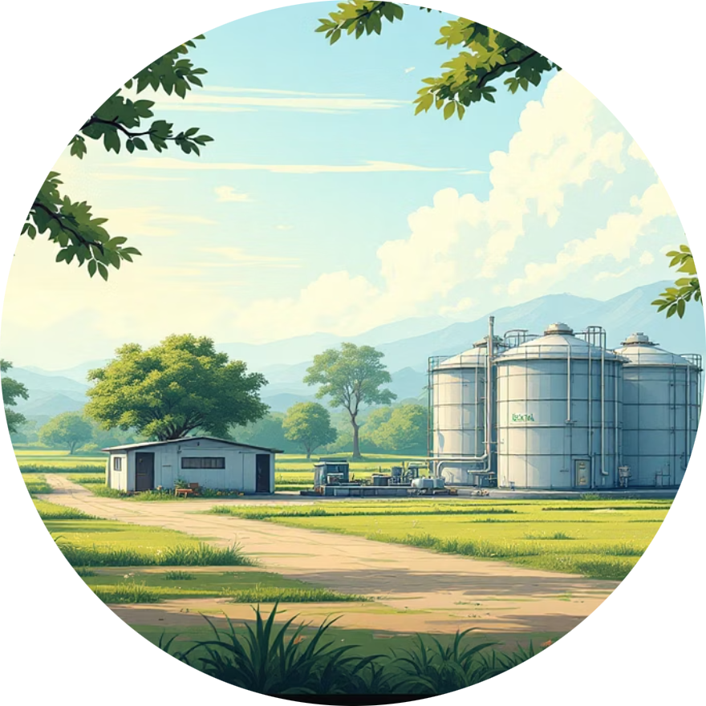
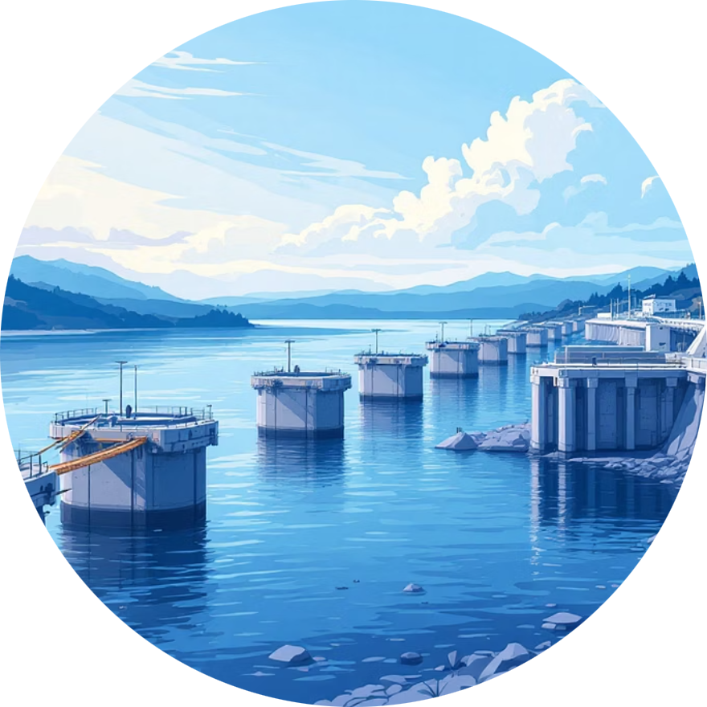
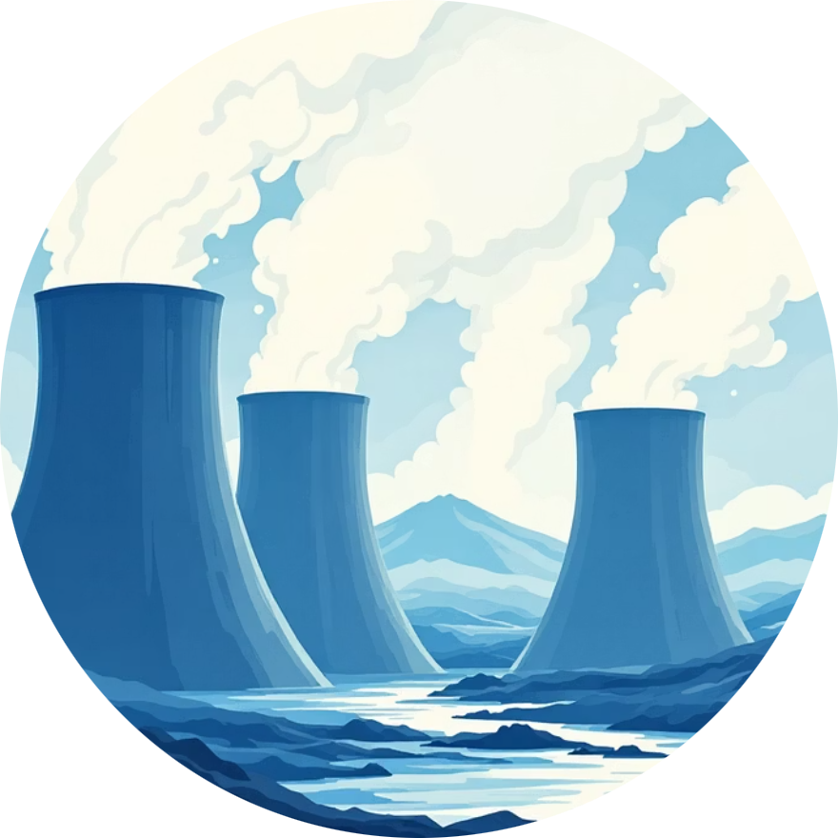
Embracing Non-Conventional Energy Sources
The increasing concerns over climate change and depleting fossil fuel reserves necessitate a shift towards sustainable and renewable energy sources. India is making significant strides in this domain.
Atomic Energy
Solar Energy
Wind Energy
Biogas
Harnesses nuclear fission, primarily from Uranium and Thorium, to generate electricity. Key plants are in Rawatbhata, Kaiga, and Tarapur.
Converts sunlight into electricity using photovoltaic cells or concentrated solar power systems. India's tropical location offers immense potential.
Utilises wind turbines to generate electricity. Coastal regions and windy plateaus offer ideal conditions for large-scale wind farms.
Produced from animal dung, agricultural waste, and organic matter, providing clean cooking fuel and fertiliser for rural households.
Tidal Energy
Geothermal Energy
Exploits the ebb and flow of ocean tides to generate power. Regions like the Gulf of Khambhat and the Sunderbans hold potential.
Taps into Earth's internal heat to generate electricity. Geothermal hotspots exist in the Himalayas and the Narmada-Son valley.

Slide 10
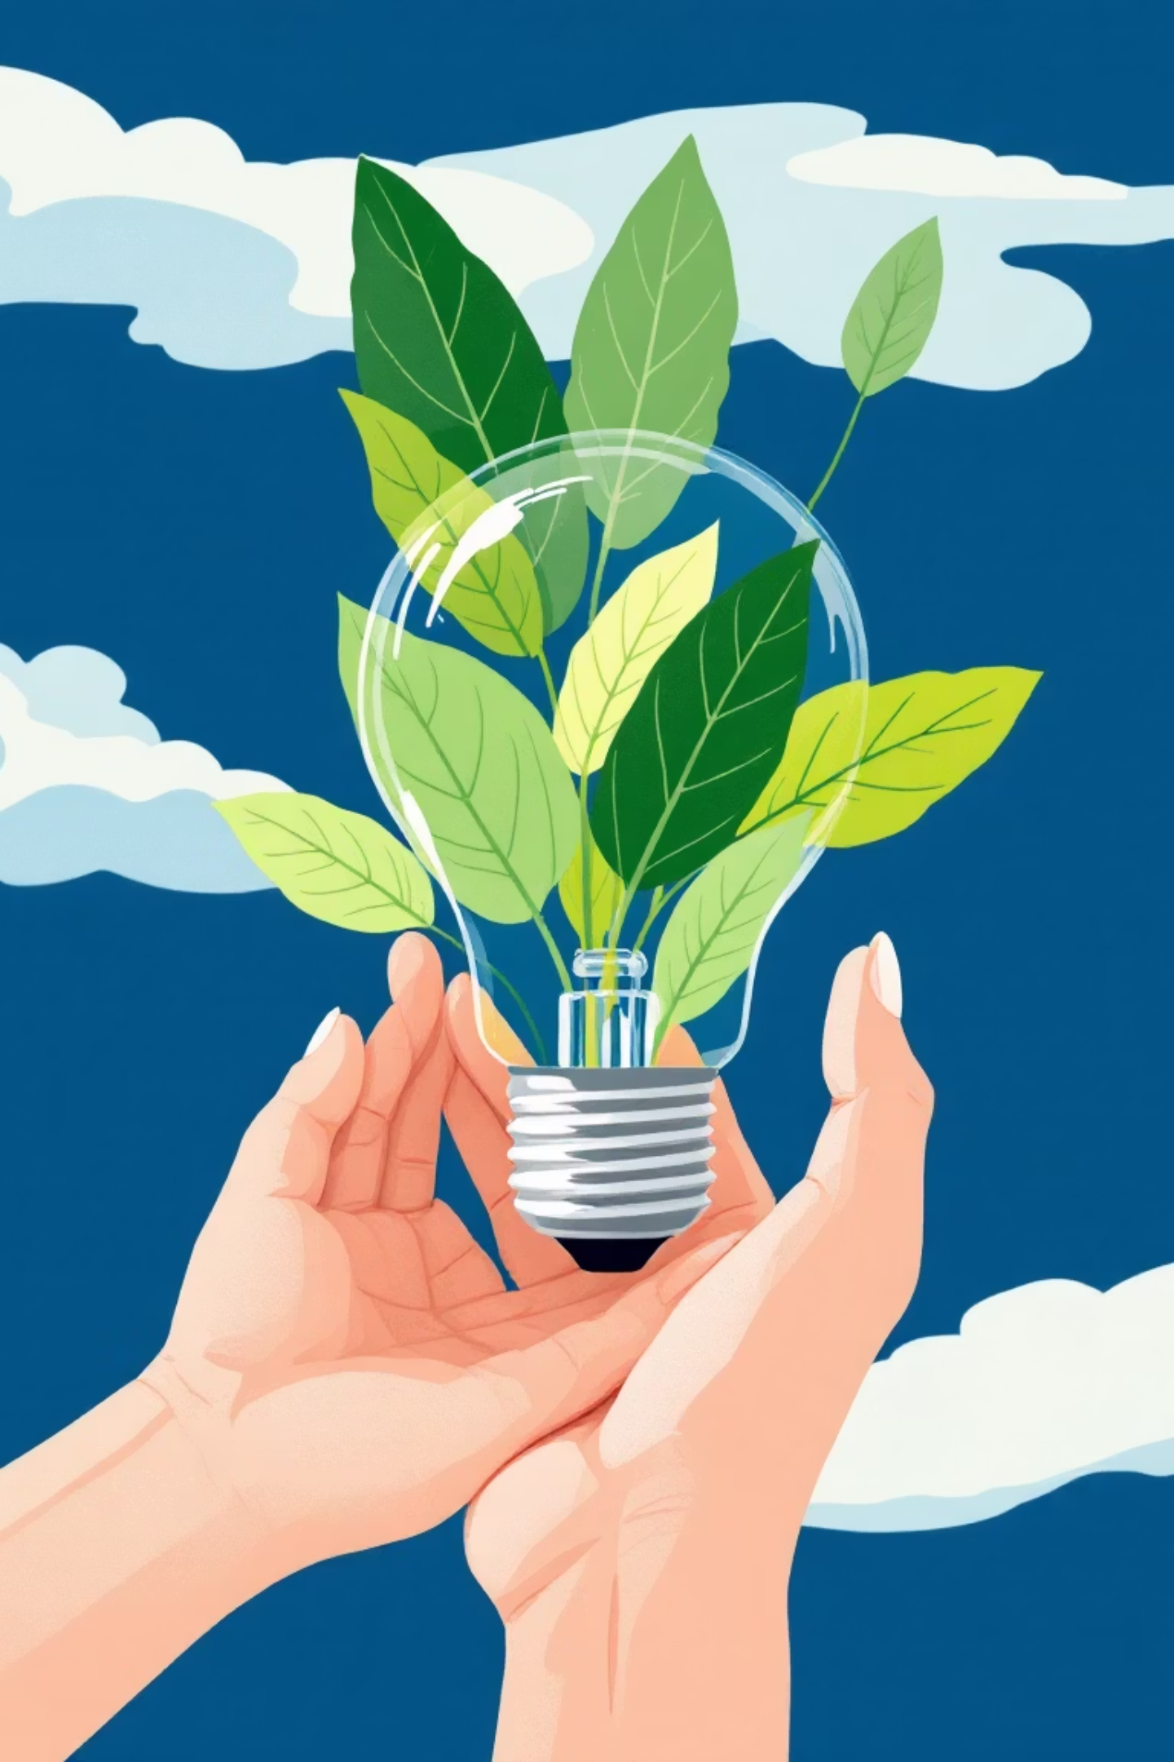
Conservation of Energy Resources: A Shared Responsibility
Efficient Use
Adopting energy-efficient appliances and technologies to reduce consumption in homes, industries, and transportation.
Promote Renewables
Investing in and promoting the widespread adoption of solar, wind, hydro, and other non-conventional energy sources.
Reduce Wastage
Minimising energy losses in transmission and distribution, and discouraging wasteful consumption habits among individuals.
Public Awareness
Educating communities about the importance of energy conservation and encouraging responsible energy consumption behaviour.
Conserving energy resources is paramount for a sustainable future, ensuring energy security and environmental protection for generations to come. Every step towards conservation is a step towards a greener planet.

