Slide 1

Chapter 5: Consumer Rights in India – Empowering the Marketplace
This presentation explores the fundamental rights of consumers in India, examining the evolution of the consumer movement and the mechanisms available for grievance redressal. We will delve into how information, quality marks, and consumer education collectively empower individuals in the marketplace.

Slide 2

Who is a Consumer in the Marketplace?
In India, a consumer is broadly defined under the Consumer Protection Act, 2019, as anyone who buys goods or avails services for personal use, not for resale or commercial gain. This definition is crucial as it forms the bedrock of all consumer protection laws.
Includes any user of goods or services with the approval of the buyer.
Specifically excludes those purchasing for commercial purposes or resale.
When consumers engage with the market, they inherently expect a certain standard: the right quality, the correct quantity, a fair price, and comprehensive information about what they are purchasing. These expectations are enshrined as fundamental rights.

Slide 3
The Consumer Movement: Protecting Your Interests
The consumer movement in India arose as a powerful response to prevalent unfair trade practices, consumer exploitation, and a significant lack of accessible information. Over decades, it has shaped policies and legislative frameworks to safeguard consumer interests.
Government Leadership
Strengthened Legislation
Regulatory Oversight
The Department of Consumer Affairs (DoCA), established in 1997, spearheads initiatives, policy formulation, and awareness campaigns, demonstrating the government's commitment to consumer welfare.
The Consumer Protection Act, 2019, marks a significant milestone, expanding consumer rights and providing stronger protections, particularly in the rapidly growing digital and e-commerce sectors.
The Central Consumer Protection Authority (CCPA) plays a vital role in regulating false and misleading advertisements, ensuring that consumers are not deceived by exaggerated claims or deceptive marketing tactics.
This collective effort aims to create a transparent and equitable marketplace where consumers can make informed decisions without fear of exploitation.

Slide 4
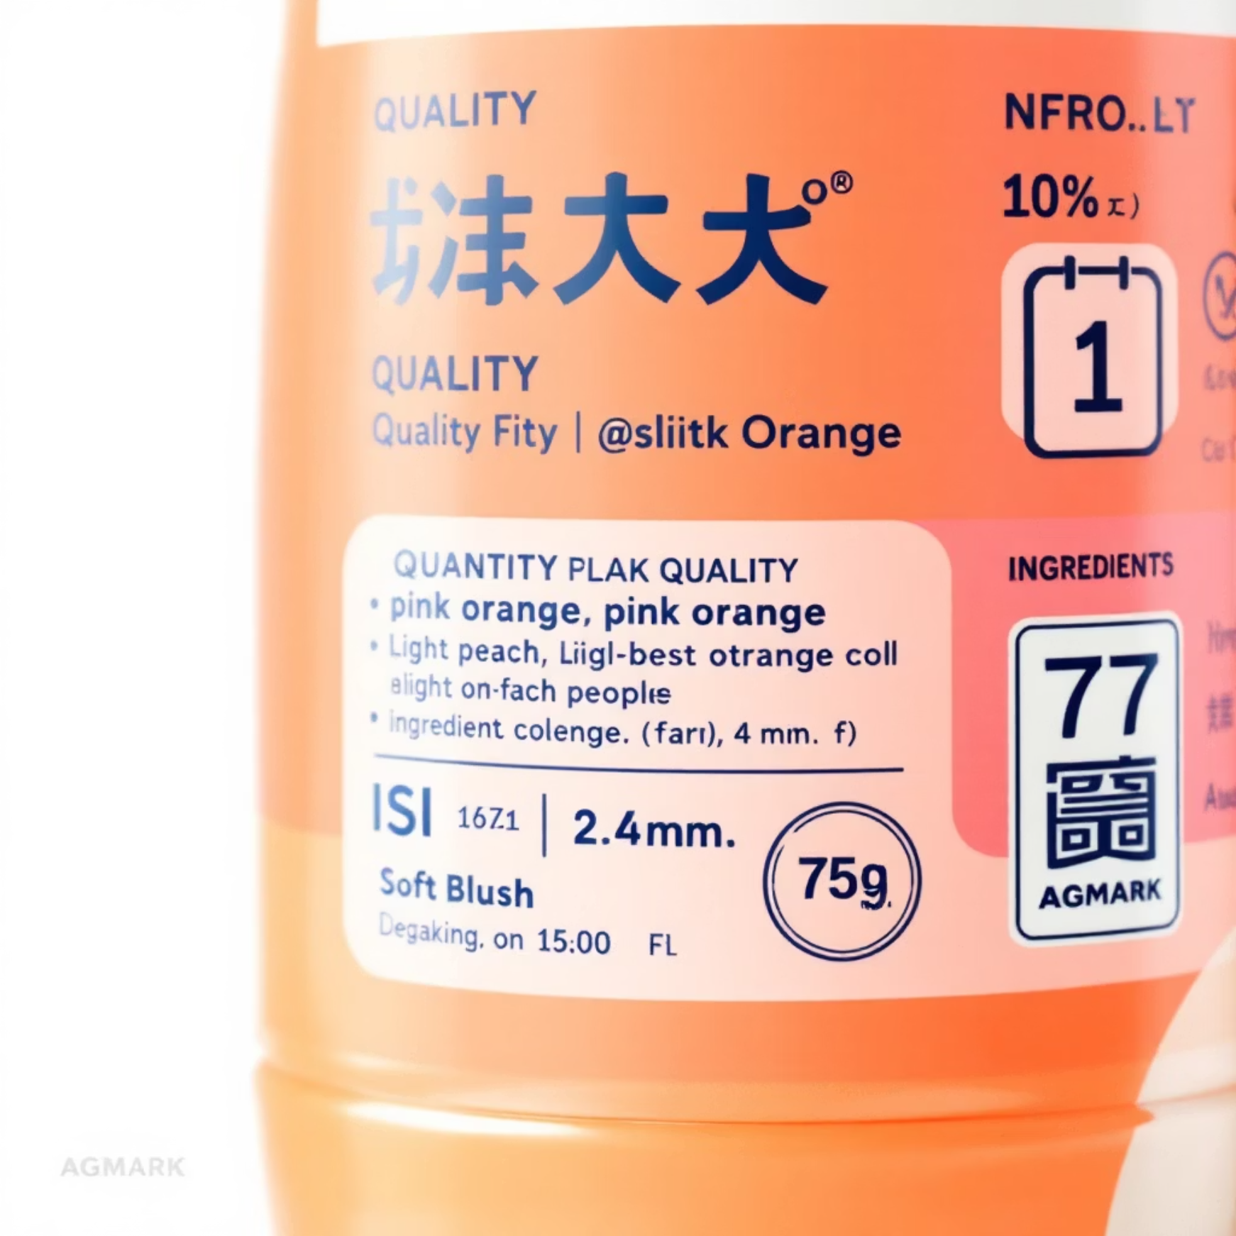

Information on Goods and Services: Your Right to Know
The Right to be Informed is a cornerstone of consumer protection, empowering individuals to make well-considered purchasing decisions. This right guarantees access to essential details about products and services.
Consumers have the right to receive complete details on the quality, quantity, price, purity, and standards of any good or service.
Transparent labels and packaging are legally mandated to provide truthful and comprehensive information, enabling informed choices.
This ensures that what you see is what you get, fostering trust and accountability in the marketplace.
Look for the ISI Mark (Bureau of Indian Standards) for industrial goods and AGMARK for agricultural products. These marks certify quality and safety, acting as reliable indicators for consumers.

Slide 5



Where Should Consumers Go to Get Justice?
India has established a robust three-tier consumer disputes redressal mechanism to ensure that consumers can seek justice swiftly and affordably without the complexities of traditional court proceedings.
District Forum
State Commission
National Commission (NCDRC)
Handles complaints involving goods or services valued up to ₹1 crore.
Addresses complaints with values ranging between ₹1 crore and ₹10 crore.
Deals with complaints exceeding ₹10 crore, led by retired Supreme Court judges to ensure highest oversight.
These forums operate with minimal court fees and do not require mandatory legal representation, making justice accessible to all. For instance, the National Consumer Disputes Redressal Commission (NCDRC) provides high-level oversight, upholding justice in significant cases.

Slide 6
Learning to Become Well-Informed Consumers
Consumer education is paramount in empowering individuals to protect their rights and make prudent purchasing decisions. India has made concerted efforts to integrate consumer awareness into daily life and formal education.
1
2
3
Education Integration
Public Awareness
Digital Platforms
Consumer education is now a part of school and university curricula, instilling knowledge of rights and responsibilities from a young age.
Iconic campaigns like "Jago Grahak Jago" (Be Aware Consumer) have significantly boosted public awareness, familiarising millions with their consumer rights and redressal avenues.
The National Consumer Helpline (NCH) and various digital platforms offer accessible channels for grievance redressal, ensuring that help is just a call or click away.
This empowerment through knowledge acts as a powerful deterrent against exploitation and unfair trade practices, fostering a more equitable marketplace for everyone.

Slide 7





ISI and AGMARK: Quality Assurance Marks
In India, the ISI and AGMARK certification marks are crucial for assuring product quality and safety, providing consumers with confidence in their purchases. They serve as reliable indicators that products meet established standards.
ISI Mark: Certified by the Bureau of Indian Standards (BIS), this mark ensures that industrial products comply with Indian Standards, guaranteeing quality and safety. You'll find it on electrical appliances, cement, and packaged drinking water, among others.
Electric fan
Bag of rice
AGMARK: This mark certifies agricultural products, ensuring they meet specific quality and purity standards. From pulses and spices to edible oils, AGMARK ensures the authenticity and quality of food items.
ISI Mark
AGMARK
Safety helmet
Bottle of honey
These marks protect consumers from substandard or hazardous products, reducing the risk of health issues and financial losses caused by faulty goods.

Slide 8
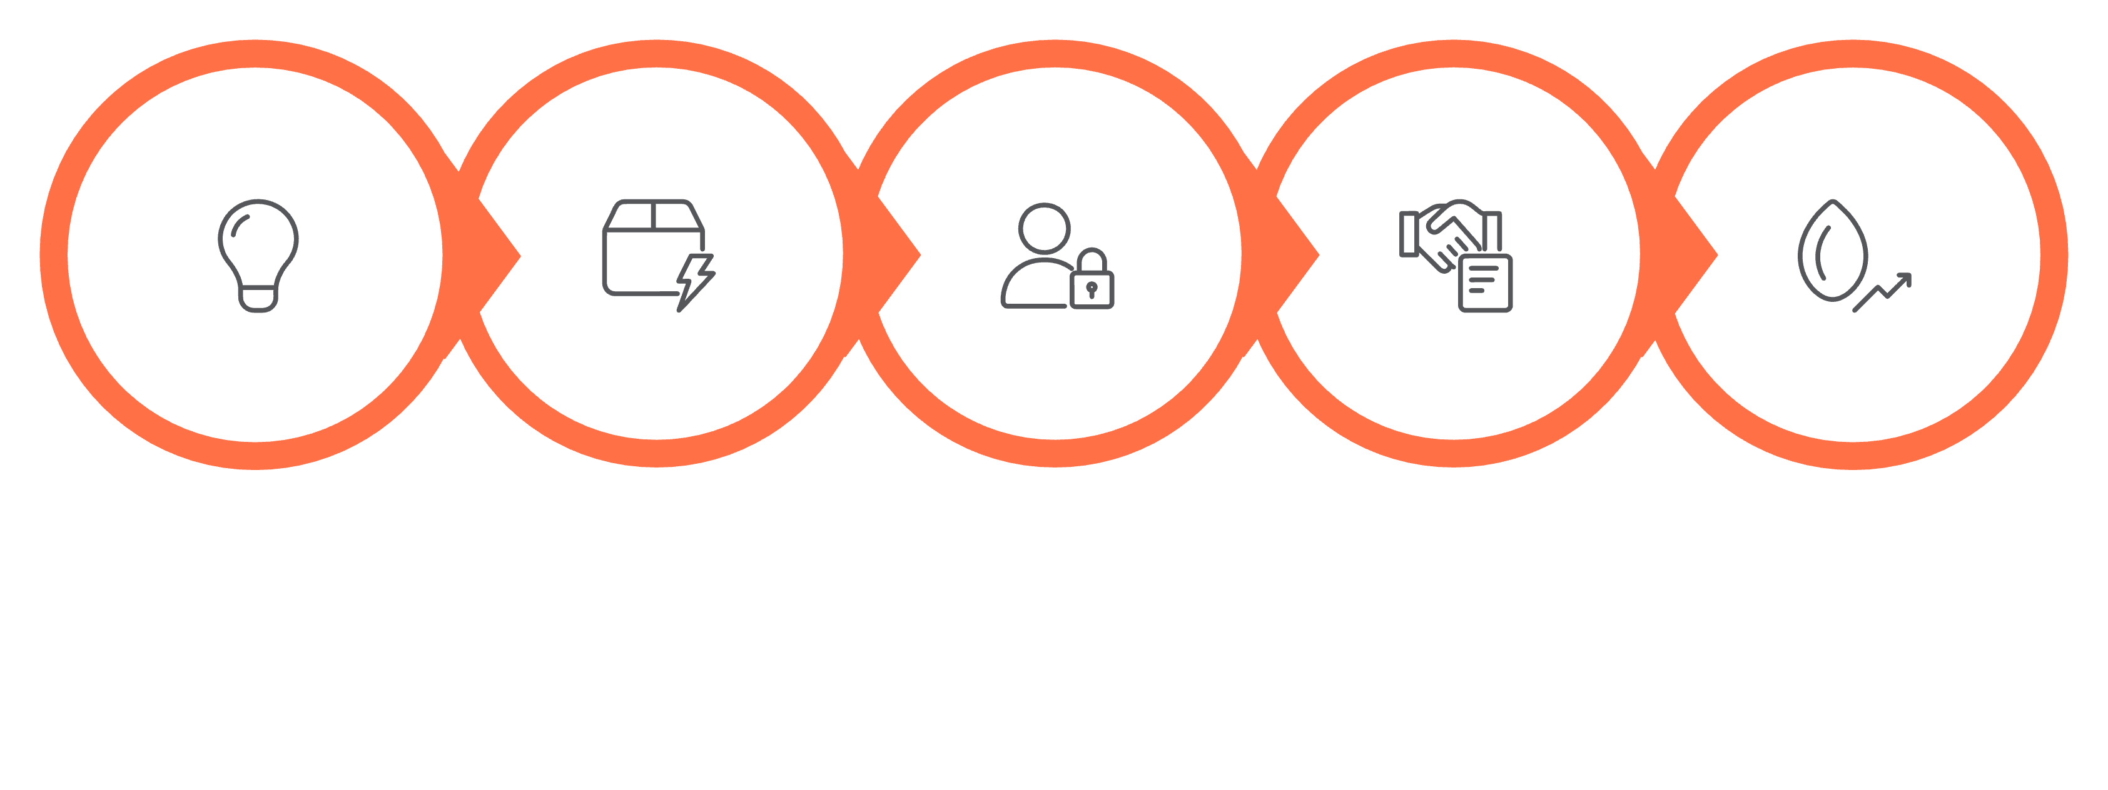





Taking the Consumer Movement Forward: Diagrammatic Overview
The consumer movement is a dynamic process involving multiple stakeholders working collaboratively to ensure consumer welfare. This flowchart illustrates the cyclical journey of consumer empowerment and justice.
Empowerment
Awareness
Reporting
Forums
Resolution
This diagram highlights how a proactive consumer, supported by robust governmental, non-governmental, and judicial frameworks, can navigate the system to achieve redressal and ultimately contribute to a stronger, more ethical marketplace.

Slide 9
Recent Consumer Justice Highlights in India
The landscape of consumer justice in India is continually evolving, with recent developments strengthening consumer protections and streamlining grievance redressal, particularly in the digital realm.
The Consumer Protection Act, 2019, extended its purview to include e-commerce and digital transactions, addressing the complexities of online marketplaces and protecting consumers from emerging digital frauds.
Landmark rulings by consumer forums have seen companies like Swiggy ordered to compensate for non-delivery and travel agencies penalised for visa application failures, reinforcing accountability.
Courts consistently uphold fundamental consumer rights, including the Right to Safety, Right to Redressal, and Right to be Heard, setting precedents for future cases.
There's an increasing adoption of technology, such as online portals and digital helplines, to facilitate faster complaint registration and resolution, making justice more accessible.
These developments underscore India's commitment to creating a responsive and effective consumer justice system.

Slide 10



Conclusion: Your Rights, Your Power
Consumer rights are not just legal provisions; they are fundamental to ensuring fair trade and fostering social justice in India's diverse marketplace. Empowering yourself with knowledge is the first step towards a fair consumer experience.
Know Your Rights
Seek Justice
Collective Strength
Understand your fundamental rights: Right to Safety, Information, Choice, Redressal, and Consumer Education. These are your armour in the marketplace.
Utilise consumer forums for grievance redressal and rely on certifications like ISI and AGMARK to protect yourself from substandard products.
An informed consumer base, united through the consumer movement, collectively ensures a transparent and ethical marketplace for everyone.
By being vigilant and informed, you contribute to a stronger, more equitable consumer ecosystem where businesses are held accountable and consumer interests are prioritised. Your awareness is your greatest power.

