Slide 1
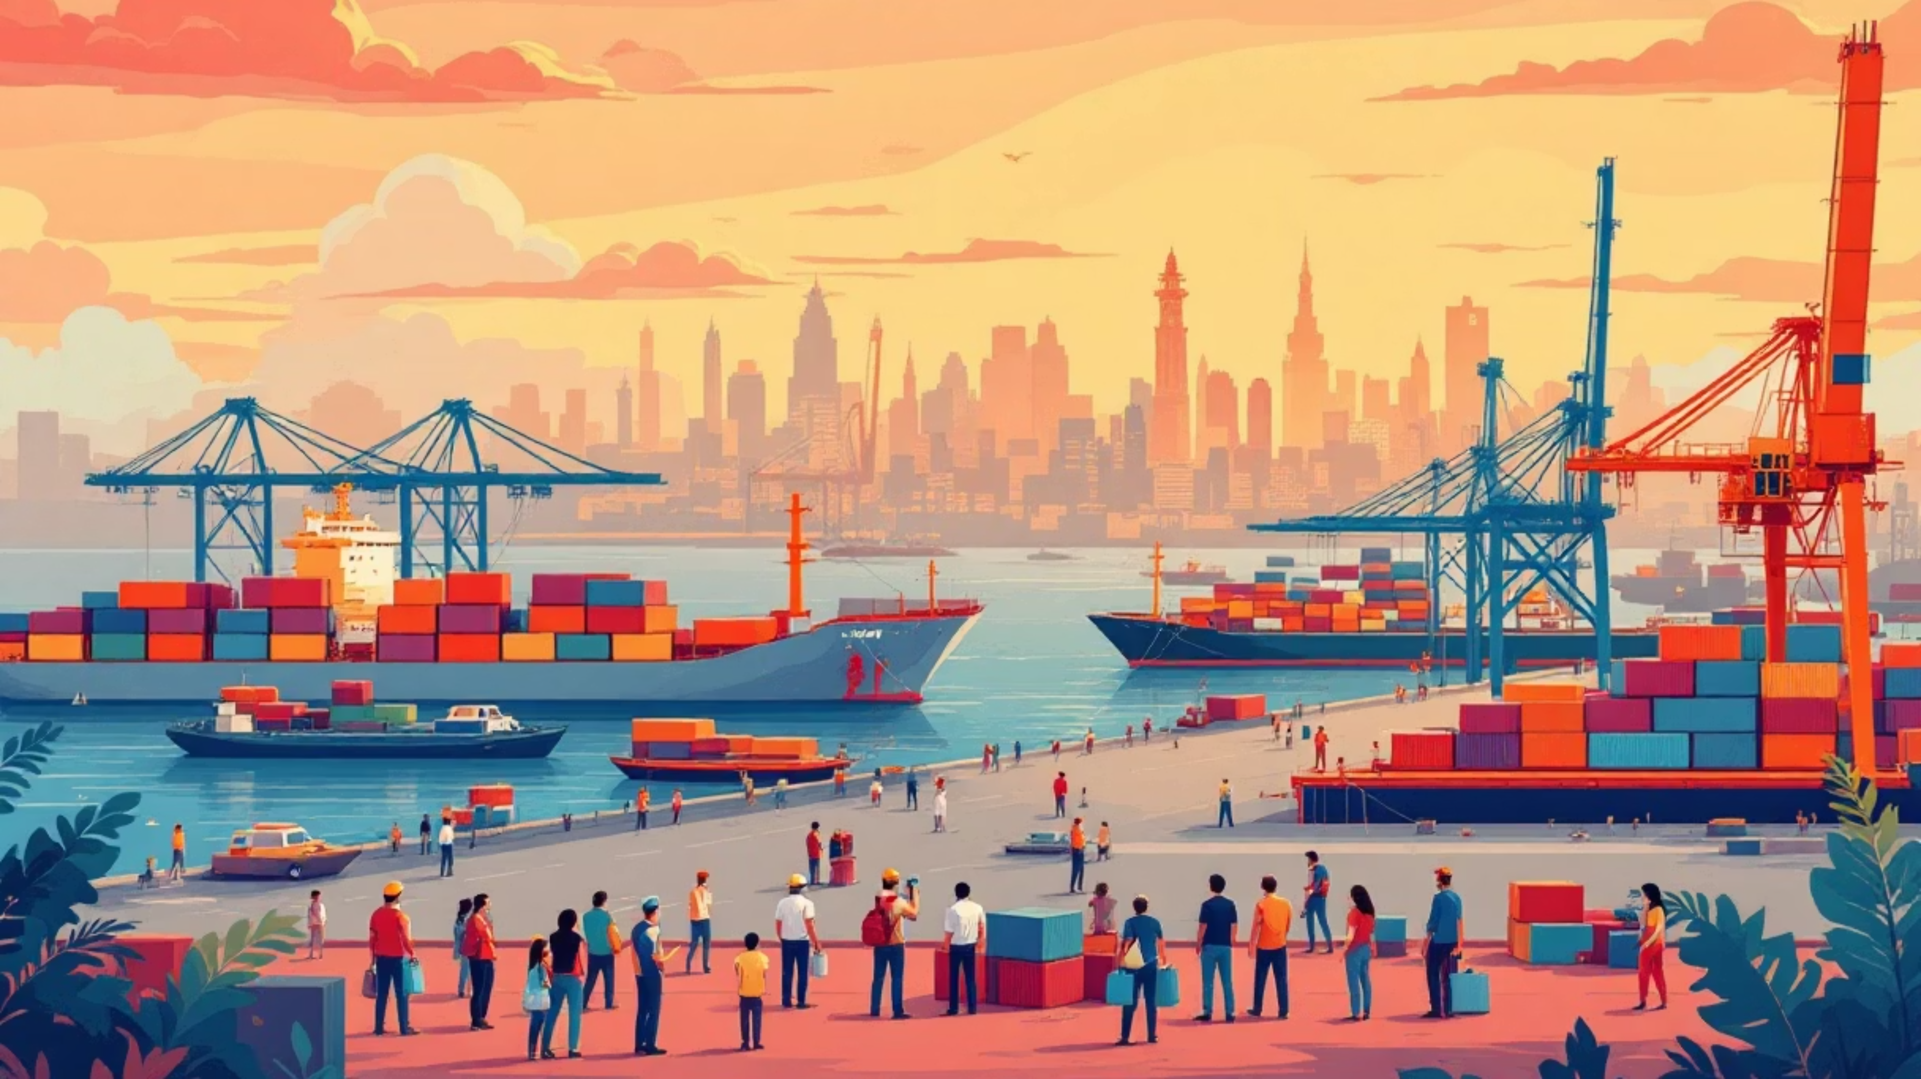
Chapter 4: Globalization and the Indian Economy
Navigating India's Transformation in a Connected World

Slide 2
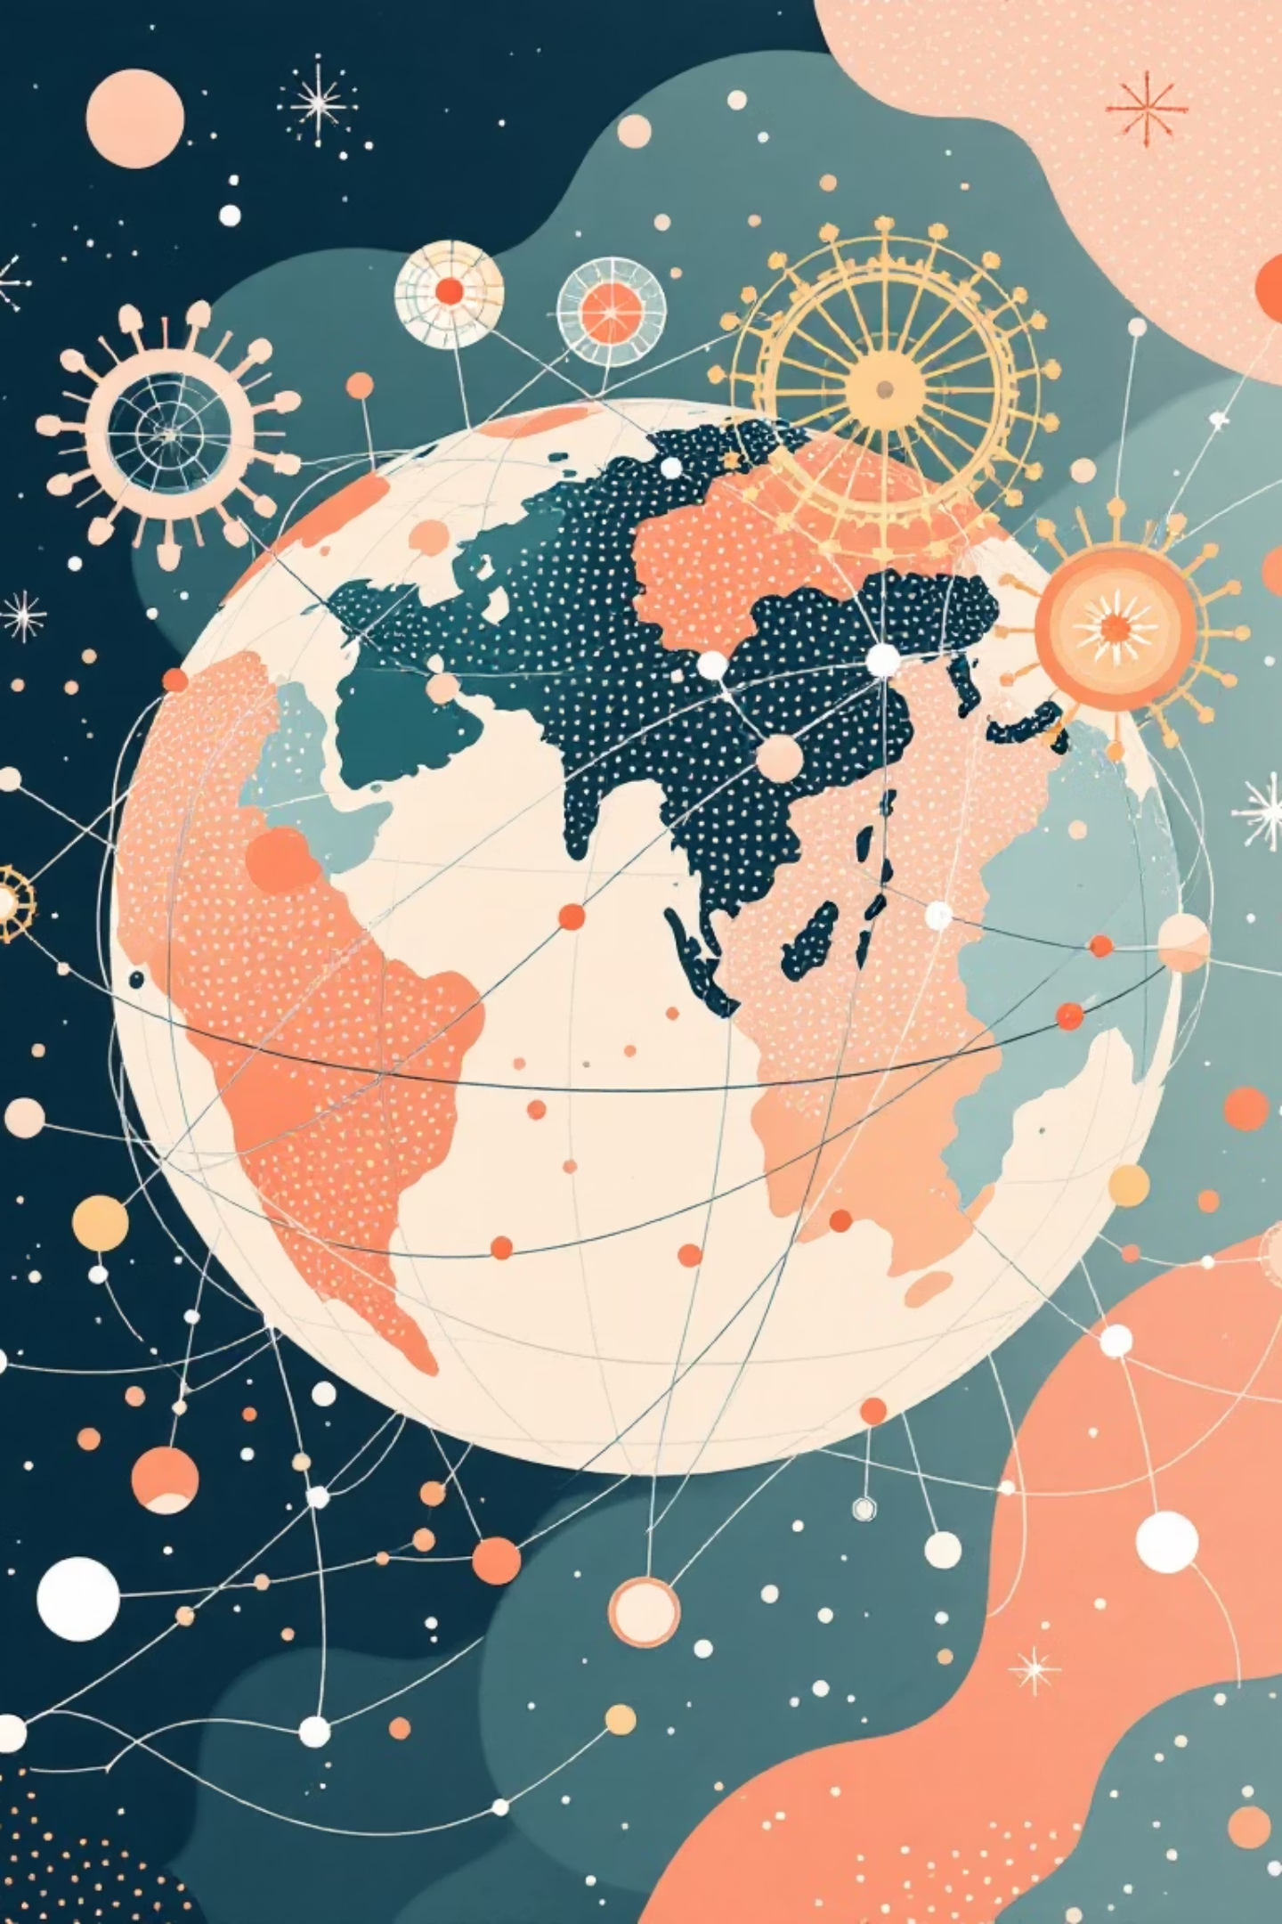
What is Globalization?
Globalization is the extensive integration of economies worldwide, facilitated by the free flow of goods, services, capital, technology, and cultural ideas. This intricate process fosters an unprecedented level of interdependence among countries, effectively transforming our diverse world into a "global village."
This phenomenon is largely driven by remarkable advancements in communication and transportation, allowing for instant connections and efficient movement across continents. It's not just about trade; it's about a fundamental shift in how societies and economies interact and evolve together.

Slide 3

Production Across Countries & Multinational Corporations (MNCs)
Multinational Corporations (MNCs) are the driving force behind global production. They strategically coordinate their manufacturing, research, and service delivery across various countries to optimise costs, leverage local expertise, and efficiently access diverse markets.
India has emerged as a particularly attractive destination, transforming into a global hub for affordable yet high-quality manufacturing and innovative IT services. This has drawn major MNCs like Infosys, TCS, and Wipro to establish and expand their operations here, making India an integral part of their global supply chains. For instance, many tech giants utilise India's vast pool of skilled engineers and cost-effective labour to develop software and provide customer support that serves global markets around the clock.

Slide 4
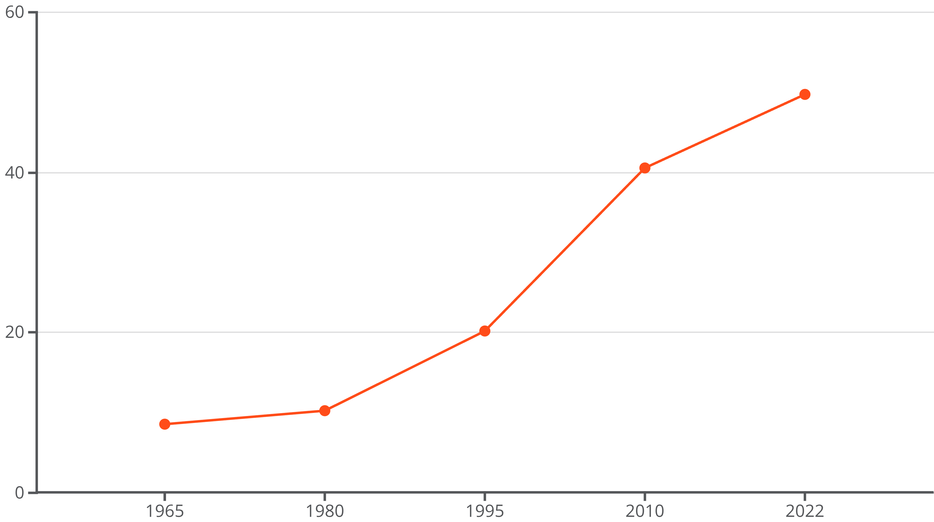
Interlinking Production & Foreign Trade
Globalization has intricately woven Indian industries into vast global supply chains, significantly boosting both exports and imports. This interconnectedness is vividly reflected in India's trade figures: trade as a share of GDP dramatically rose from 8.5% in 1965 to nearly 50% in 2022, underscoring its growing integration into the global economy.
India's key trading partners include economic powerhouses like China, the US, UAE, and the European Union, demonstrating a diversified and robust trade network. A pivotal moment was the liberalisation policies initiated in 1991, which systematically reduced tariffs and eased foreign investment restrictions. These reforms acted as a catalyst, leading to an exponential surge in trade volumes and cementing India's position as a significant global trading nation.

Slide 5
Factors Enabling Globalization: Technology & Liberalization
Technological Revolution
Economic Liberalization
WTO Engagement
Rapid advancements in information technology (IT) and communication have virtually eradicated geographical barriers. This has enabled businesses to operate globally in real-time, facilitating everything from remote team collaborations to seamless international transactions. The internet, mobile technology, and advanced logistics have been game-changers.
India's landmark 1991 economic reforms were crucial. They dismantled the "License Raj," opening up markets, encouraging foreign direct investment (FDI), and reducing protectionist policies. This strategic shift signaled India's readiness to engage with the global economy.
India's membership in the World Trade Organization (WTO) further integrated it into the global trading system, allowing it to adhere to and shape international trade rules. While engaging with global norms, India has consistently advocated for the interests of developing countries, ensuring a balanced approach to global trade.

Slide 6
Impact of Globalization on India’s Economy
Globalization has been a catalyst for monumental economic transformation in India. The nation's GDP growth accelerated dramatically from an average of 3.5% annually in the pre-1991 era to an impressive over 7% annually post-reforms. This sustained growth translated into tangible benefits for the average Indian.
Per capita income soared from a mere $304 in 1991 to over $2,600 in 2023, reflecting significant improvements in living standards. Crucially, poverty rates experienced a dramatic decline, with extreme poverty falling below 1%. The IT and service sectors flourished exponentially, creating millions of new jobs and solidifying India's position as a global leader in technology and services.
7%
$2,600
1%
Average GDP Growth Post-1991
Per Capita Income (2023)
Extreme Poverty Rate (Below)
A significant acceleration from pre-liberalization rates, demonstrating robust economic expansion.
A substantial increase from $304 in 1991, indicating improved living standards.
A dramatic reduction in poverty, showcasing globalization's role in economic upliftment.

Slide 7
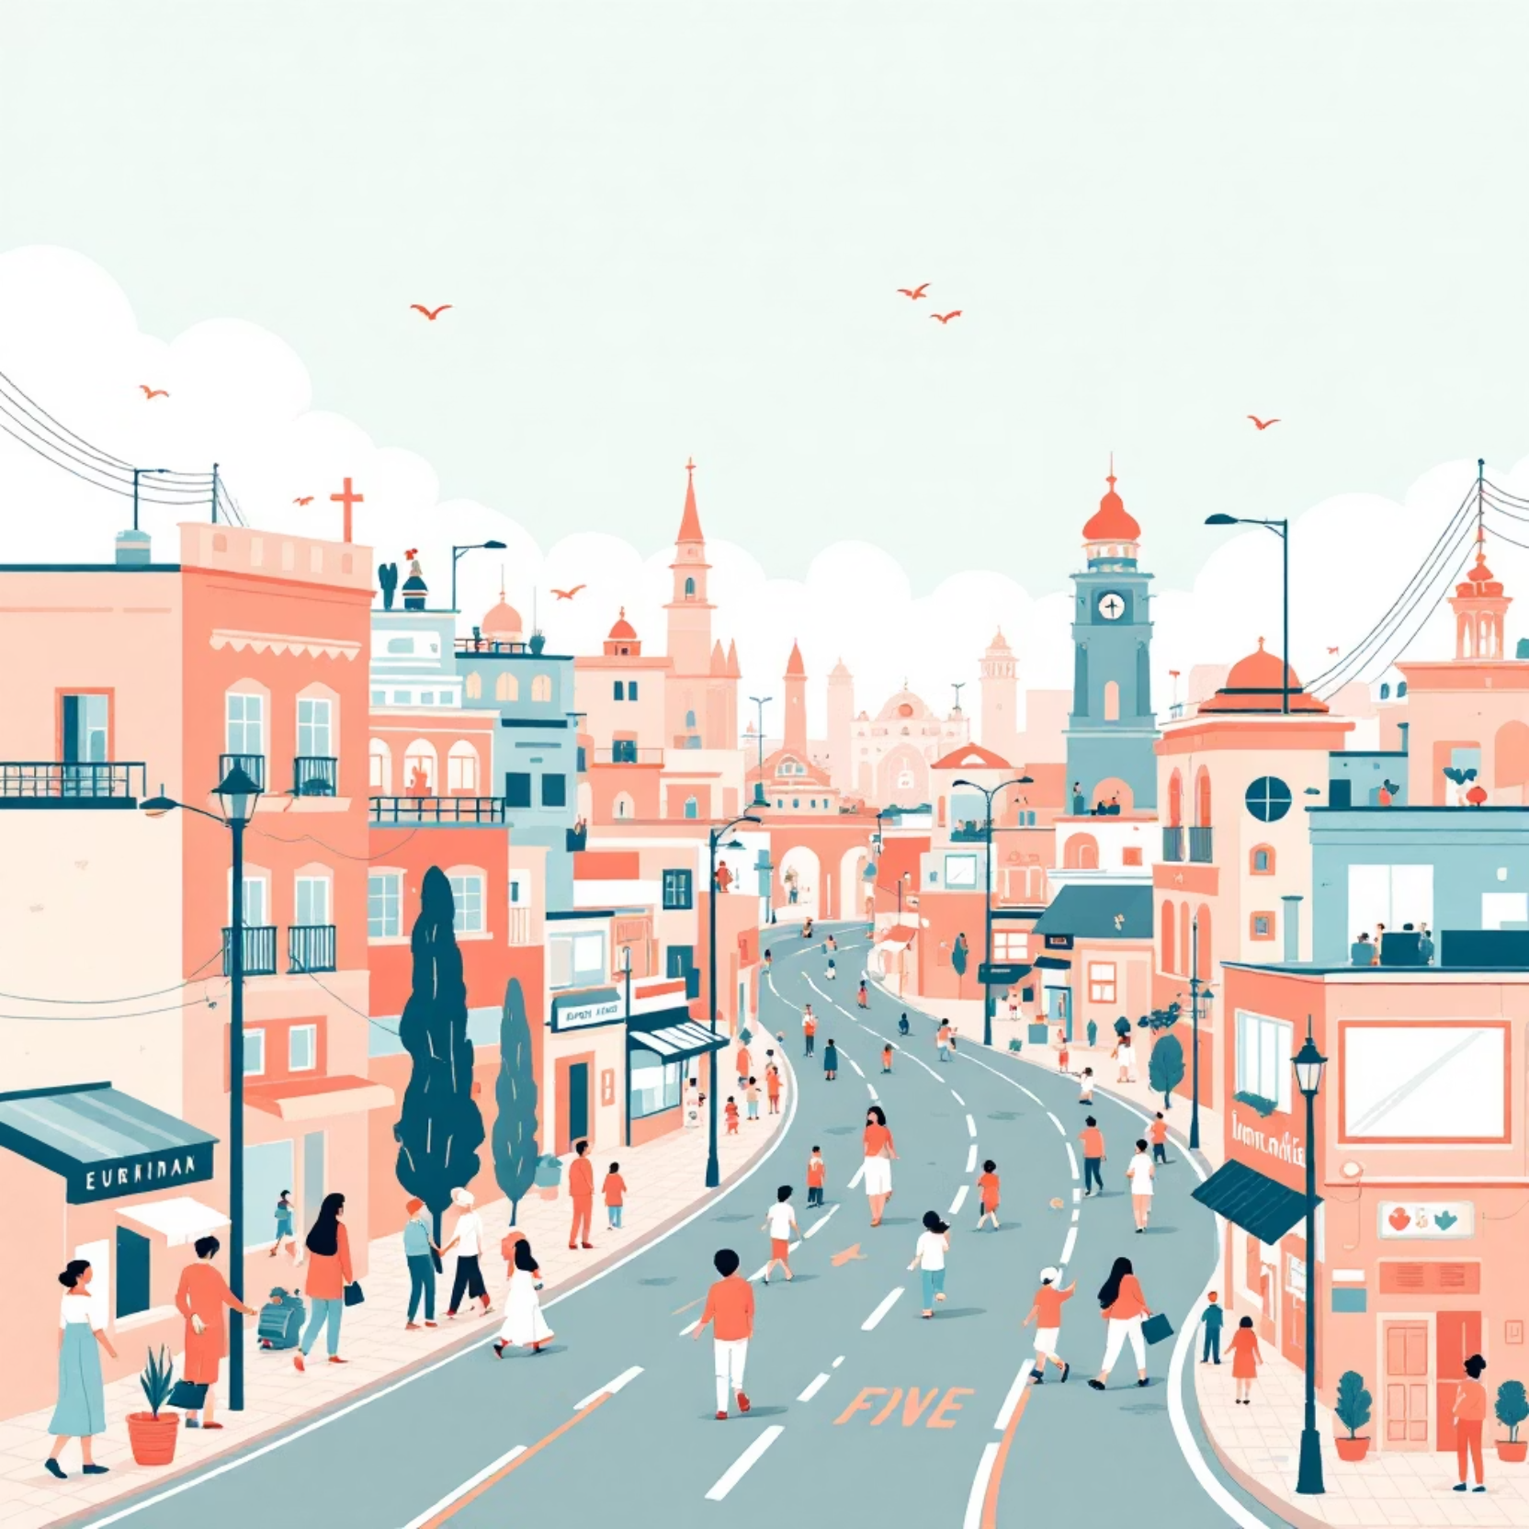
Social and Economic Changes
Globalization brought significant social shifts, including increased urbanization and a vibrant cultural exchange as India integrated more deeply with the world. The establishment of Special Economic Zones (SEZs) and Export Processing Zones (EPZs) played a pivotal role in job creation, stimulating local economies and drawing in large numbers of skilled and unskilled labour.
However, the benefits have been unevenly distributed. Growth has often concentrated in economically advanced states such as Maharashtra, Karnataka, and Tamil Nadu, exacerbating regional disparities. This has led to challenges like rising inequality and job displacement in traditional sectors, as they struggle to compete with globalised industries.

Slide 8





The Struggle for Fair Globalization
India has consistently championed for a more equitable global trading system, advocating for fair trade rules that genuinely protect the interests of developing nations during WTO negotiations. This active stance underscores its commitment to ensuring that globalization benefits all countries, not just the economically dominant ones.
Significant concerns persist regarding equitable market access for developing country products, the sensitive issue of intellectual property rights, and the impact of agricultural subsidies in developed nations. Domestically, ongoing debates focus on striking the right balance between embracing global openness and protecting vulnerable local sectors, ensuring that economic growth remains inclusive and sustainable for all segments of Indian society.
Open markets
Safety nets
Protecting Vulnerable Sectors
Global Integration
Trade rules
Targeted support

Slide 9

Recent Economic Trends & Global Position
India has solidified its position as the world’s third-largest economy by purchasing power parity, reflecting its growing global influence. The fiscal year 2024-25 witnessed robust growth of 6.5%, primarily fuelled by strong private consumption and increased investment across various sectors.
Inflation eased to a manageable 2.1% in mid-2025, providing room for potential monetary easing measures. Despite facing persistent geopolitical and global trade challenges, India continues to make steady progress in climbing global economic rankings. Its resilient economy and strategic reforms position it as a critical player in shaping the future of global commerce.

Slide 10
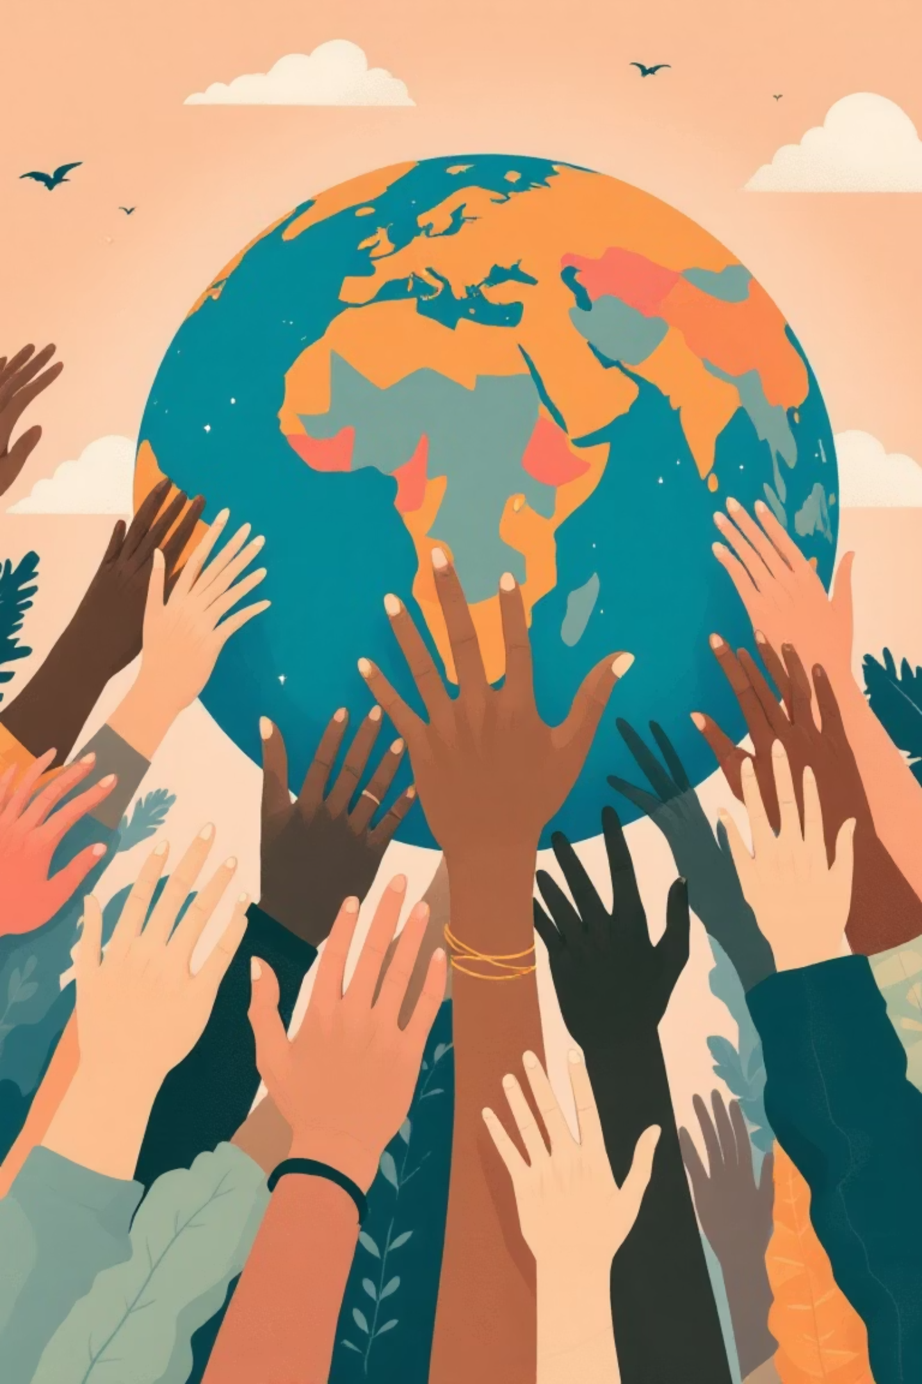
Conclusion: Globalization’s Promise and Challenges for India
Globalization has been a monumental force, transforming India from a historically closed economy into a vibrant global powerhouse. It has unlocked unprecedented opportunities for economic growth, technological advancement, and job creation.
However, this journey demands astute policymaking to ensure that the benefits are fair and inclusive for all citizens. The future hinges on India’s ability to delicately balance continued global integration with the vital need to protect its diverse economy and societal fabric.
India’s complex and inspiring journey serves as a powerful testament to the ongoing, global quest for a truly fair globalization that works equitably for everyone.

