Slide 1
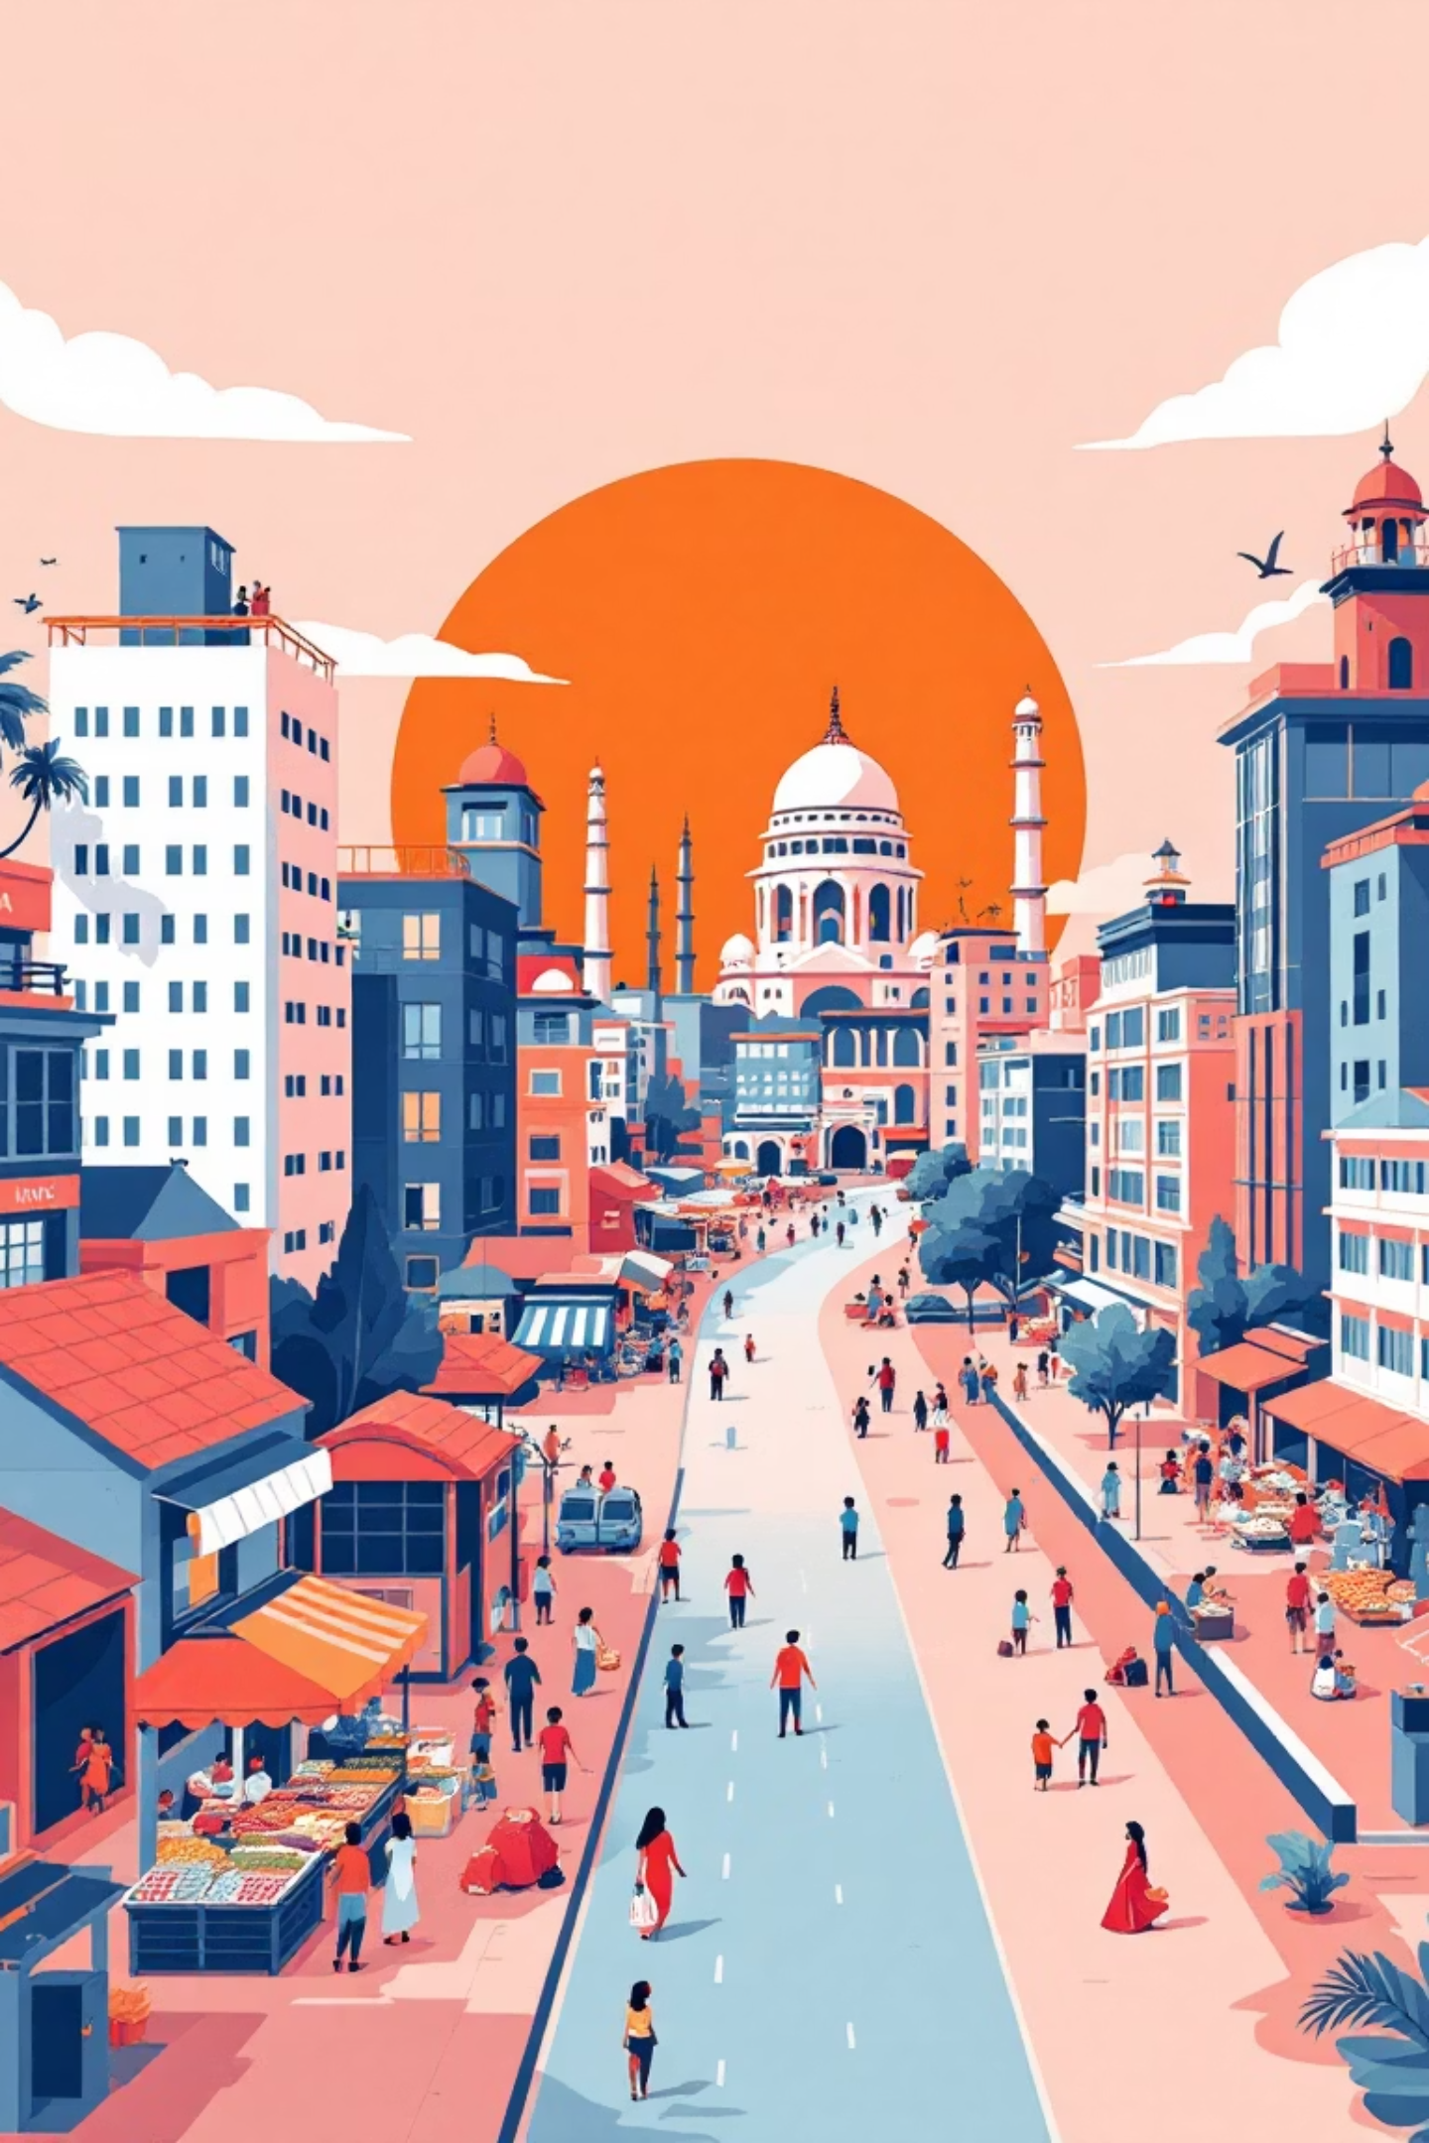
Chapter 2: Sectors of the Indian Economy
Welcome to a comprehensive exploration of the Indian economy's various sectors. This presentation will unravel the intricate layers that constitute India's economic fabric, from traditional primary activities to the burgeoning service sector, and how these have evolved over time.

Slide 2



ESSENTIAL FRAMEWORK
Understanding the Three Sectors of Economic Activity
Primary Sector
Secondary Sector
Tertiary Sector
Encompasses activities directly utilising natural resources like agriculture, forestry, fishing, and mining. These are the foundational elements of any economy, providing raw materials.
Involves processing raw materials from the primary sector into finished goods. This includes manufacturing, industrial production, and construction, adding value to raw products.
Also known as the service sector, it provides intangible services rather than goods. This vast sector includes trade, finance, education, healthcare, and public administration, supporting both other sectors and end consumers.
These three sectors form the fundamental framework that underpins India's complex economic structure and drives its growth.

Slide 3
ECONOMIC CONTRIBUTION
Comparative Overview of the Three Sectors
Sector
Activities Included
Employment Share (2023)
GDP Contribution (2023-24)
Primary
Farming, forestry, fishing, mining
~44%
17.7%
Secondary
Manufacturing, construction, utilities
~28%
27.6%
Tertiary
Services, trade, finance, public admin
~34%
54.7%
As observed in the table, while the Primary sector continues to employ the largest share of India's workforce, the Tertiary (Services) sector is the dominant contributor to the nation's Gross Domestic Product. This highlights a significant shift in India's economic landscape over recent decades.

Slide 4



EVOLUTION OF AN ECONOMY
Historical Changes in Sectoral Composition in India
The Early Years (1950-51)
Transition Begins (1973-74)
Services Soar (2013-14)
Post-independence, India's economy was agrarian. The primary sector, primarily agriculture, contributed a dominant 51.8% to the GDP, with services at a nascent 33.3%. This period reflected a typical developing economy heavily reliant on farming.
By the 1970s, the primary sector's GDP share began its gradual decline, while the secondary (industrial) and tertiary (services) sectors showed early signs of growth. This marked the initial phase of diversification in the Indian economy.
The turn of the millennium witnessed a significant transformation. The services sector surged, contributing a massive 57% to the GDP, reflecting India's emergence as a global IT and service hub. Concurrently, the primary sector's contribution dropped below 20%.
This historical progression illustrates India's journey from an agrarian economy to a service-oriented powerhouse, driven by strategic industrialisation and liberal economic policies.

Slide 5
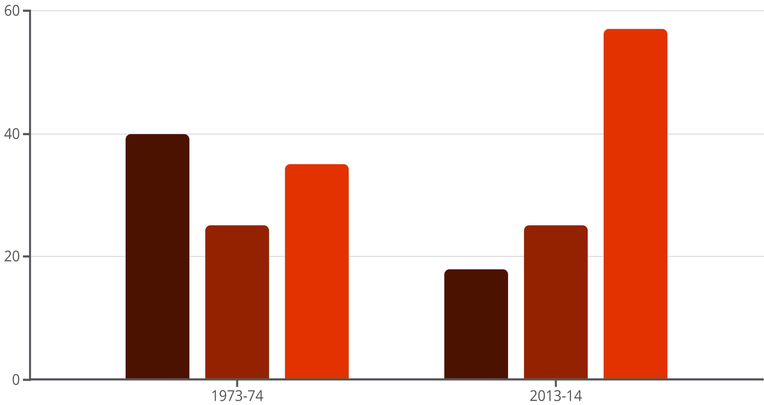
THE GREAT SHIFT
GDP by Sector: 1973-74 vs 2013-14
Primary
Secondary
Tertiary
This bar graph visually encapsulates the profound shift in India's economic structure over four decades. It vividly portrays the declining dominance of the primary sector and the robust expansion of the tertiary sector, solidifying its position as the largest contributor to India's GDP.

Slide 6
FORMAL VS. INFORMAL
Organized vs Unorganized Sectors: Definitions & Comparison
Sector Type
Characteristics
Examples
Organized
Registered with the government, adheres to labour laws, provides social security benefits, formal employment contracts.
Public sector undertakings, large private companies, banks, IT firms, government departments.
Unorganized
Informal, unregulated, lacks formal employment contracts, often without social security benefits or job security.
Small farmers, street vendors, daily wage labourers, artisans, small shop owners.
The distinction between organized and unorganized sectors is crucial for understanding labour dynamics and policy implications in India. While the organized sector offers better terms of employment, the unorganized sector continues to be the primary employer for a large segment of the Indian population.

Slide 7
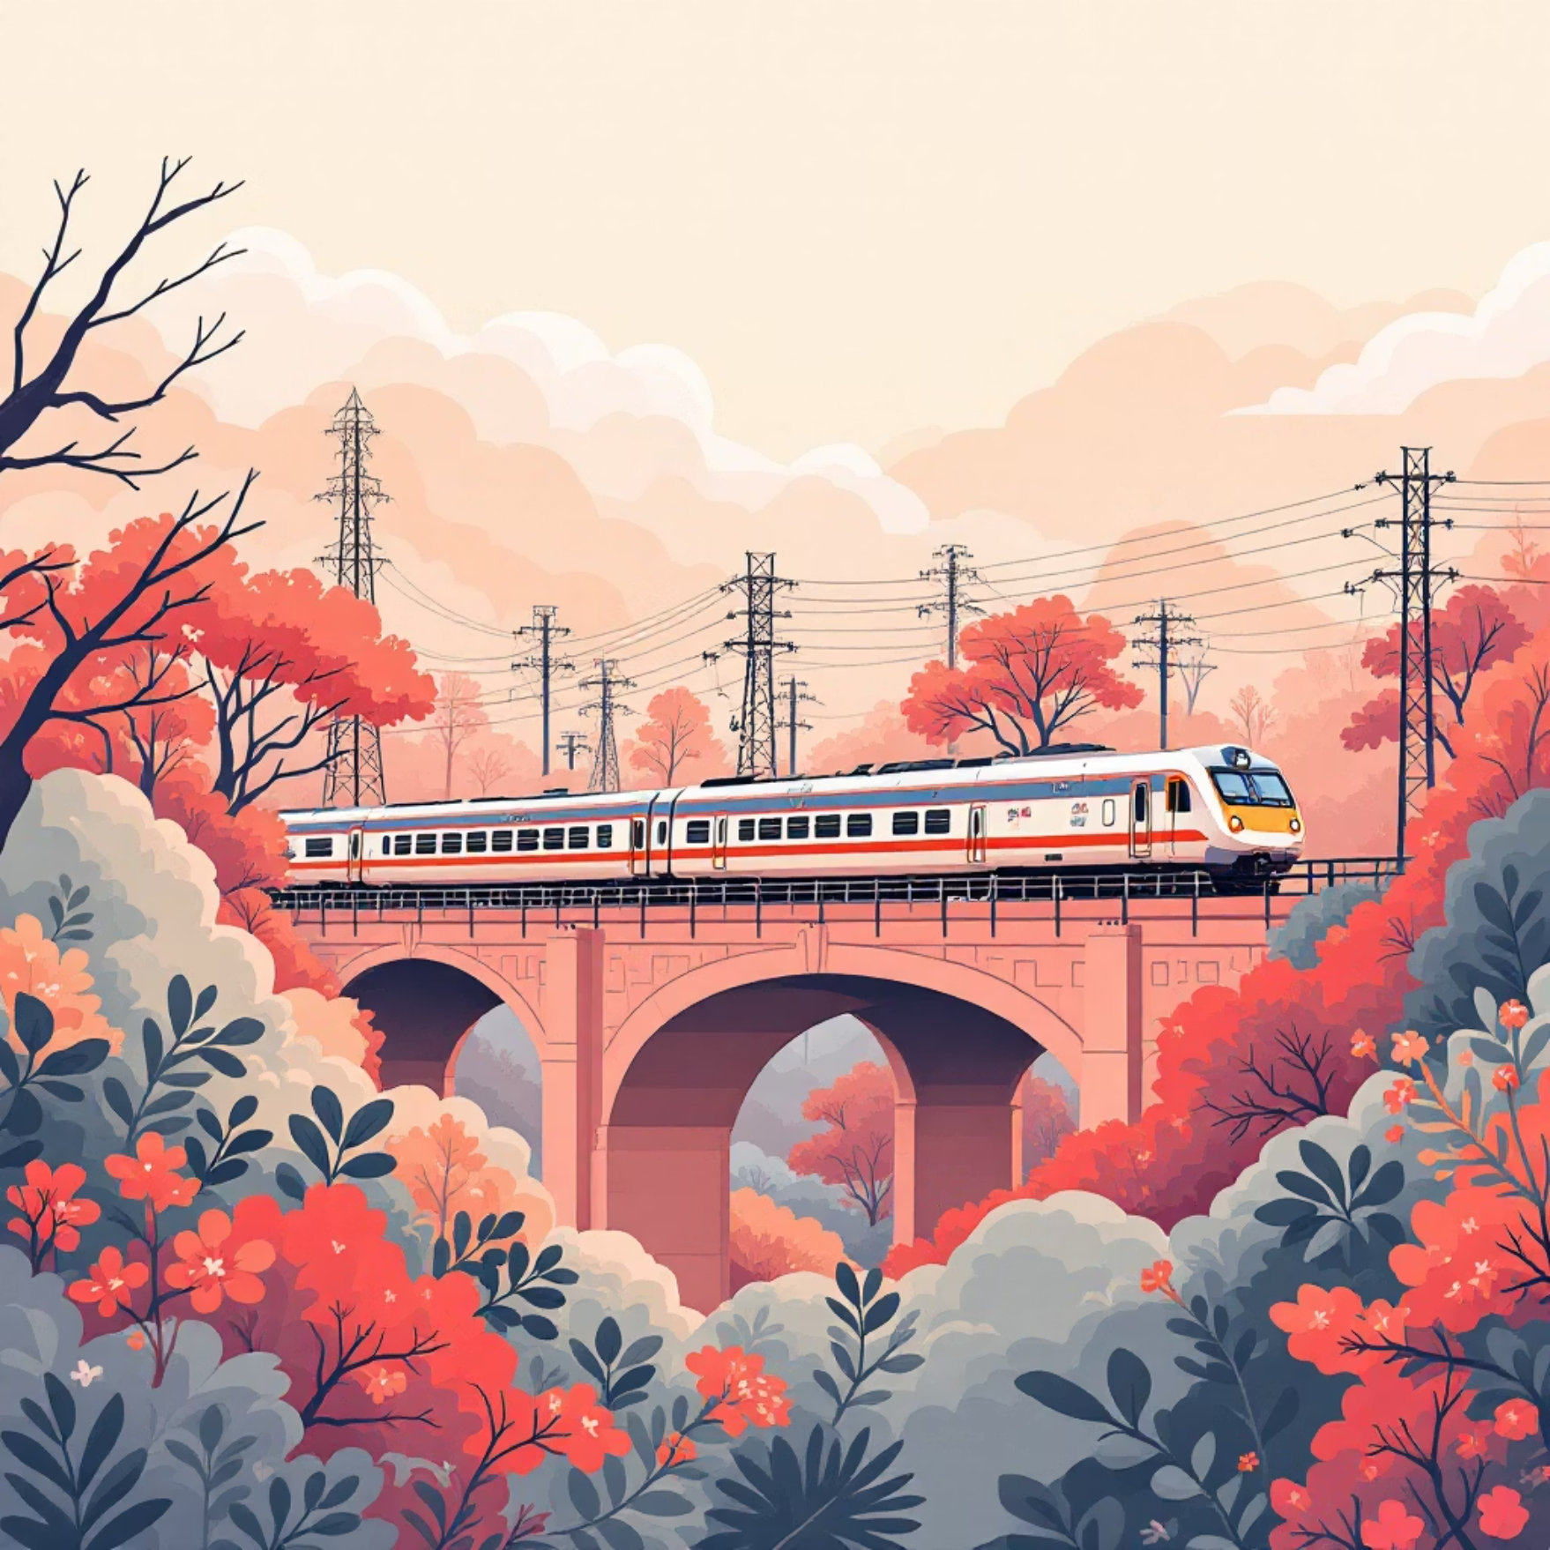
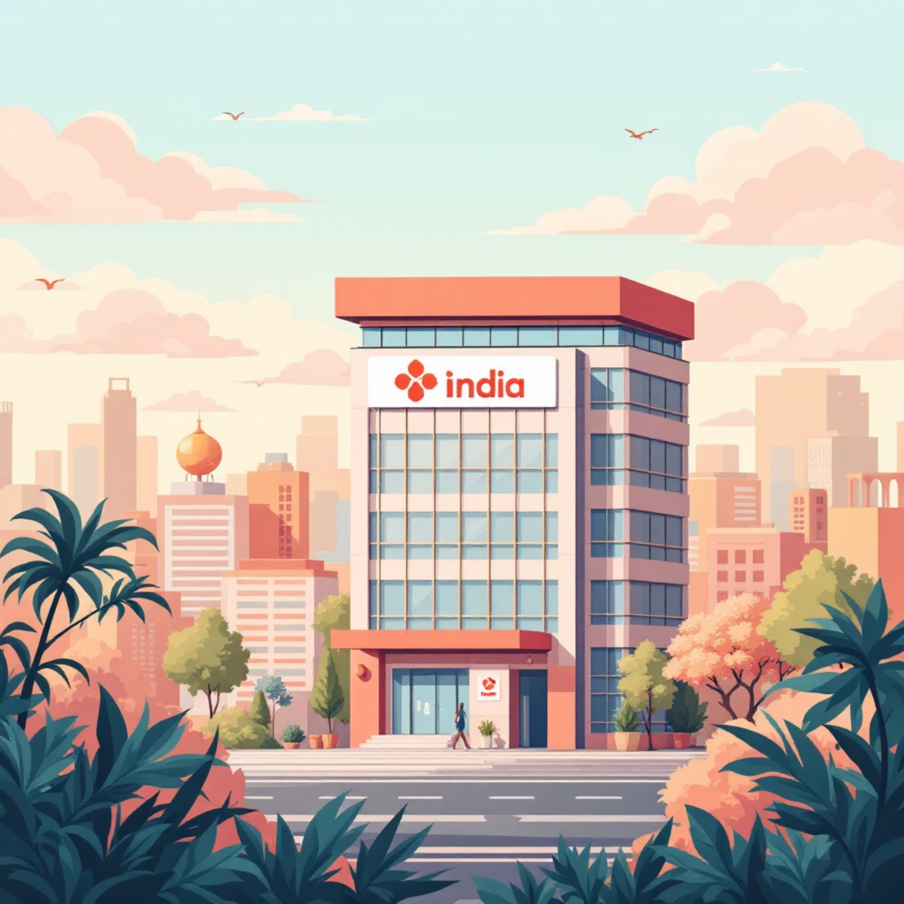
WHO OWNS WHAT?
Sectoral Division by Ownership: Public vs Private
Public Sector
Private Sector
These are enterprises wholly or majority-owned and controlled by the government. Their primary motive is public welfare and providing essential services to citizens. Examples include Indian Railways, public sector banks, and defence establishments like Bharat Heavy Electricals (BHEL).
Comprises businesses owned and operated by individuals or groups of individuals, driven primarily by profit. This ranges from small proprietorships and partnerships to large corporations like the Tata Group and Reliance Industries. Post-liberalisation, its contribution to the Indian economy has grown substantially.
India's economic model is a mixed one, with both public and private sectors playing significant, albeit evolving, roles in national development.

Slide 8
CONTRIBUTION MATRIX
Sectoral GDP Contribution Snapshot (2023-24)
Sector
Public Sector Share
Private Sector Share
Primary
Minimal; limited to specific state-owned agricultural corporations and research
Dominant; majority of agricultural production, fishing, and mining is privately owned
Secondary
Significant in heavy industries (e.g., steel, energy), defence production, and certain utilities
Majority in manufacturing, construction, and consumer goods; rapidly expanding
Tertiary
Strong presence in public administration, defence, education, healthcare, and state-owned transport/communication
Predominant in IT, finance, trade, hospitality, private education, and healthcare; fastest-growing segment
This snapshot demonstrates the diverse roles and contributions of public and private ownership across India's economic sectors, highlighting the increasing dynamism of the private sector, particularly in services and manufacturing.

Slide 9
SUMMARISING THE JOURNEY
Key Takeaways on Indian Economic Sectors
Services Sector Leadership
The services sector's dominant contribution to GDP underscores India's global prowess in IT, business process outsourcing, and other service industries, making it a key growth engine.
Agricultural Employment & Output Disparity
Despite employing the largest segment of the population, agriculture's diminishing GDP share indicates a need for increased productivity and value addition in this vital sector.
Steady Industrial Growth
The industrial sector continues its steady growth, crucial for job creation, manufacturing capabilities, and infrastructure development, essential for a balanced economy.
Organized Sector's Importance
Expanding the organized sector is vital for providing formal employment, social security, and better working conditions, contributing significantly to economic stability.
Mixed Economy Dynamics
The interplay between public and private sectors defines India's mixed economy, with evolving roles and increasing private participation driving innovation and competition.

Slide 10

FORWARD LOOKING
Conclusion: The Dynamic Landscape of India’s Economy
India's economic sectors have undergone a phenomenal transformation since independence, reflecting a journey of resilience and adaptation. Understanding these sectoral shifts is paramount to grasping India's remarkable growth story and its immense future potential.
Continued focus on fostering balanced growth across all sectors—from modernising agriculture and bolstering manufacturing to innovating services—will be crucial for driving inclusive development and creating widespread prosperity.
With its diverse economic base and dynamic entrepreneurial spirit, India is not just a participant but a significant force poised to leverage its unique strengths for sustained global leadership in the years to come.

